Slide 1
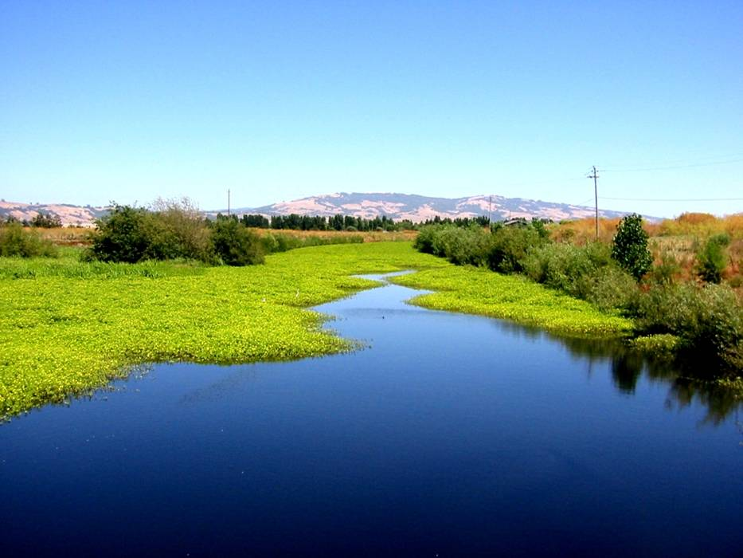


Item 2: Workshop on the Draft Water Quality Trading Framework for the Laguna de Santa Rosa Watershed
June 29, 2017
David Kuszmar, P.E.

Slide 2
Workshop Outline
Introduce Board Agenda Packet (Item 2)
Review watershed conditions and regulatory actions to date in the Laguna de Santa Rosa
Review local and national efforts supporting Water Quality Trading (WQT)
Review staff’s approach, guiding principles, and flow chart for the Draft Framework
Receive initial feedback from the Board and public

Slide 3
Today’s Board Agenda Packet
(Item 2)
Executive Officer’s Summary Report (EOSR)
Draft Resolution No. R1-2017-0027
Draft Water Quality Trading Framework
Excerpts from National Network’s Options and Considerations Document
Notice of Public Workshop and Opportunity to Comment (Due: July 21, 2017)
Links to Additional Materials on the Regional Water Board’s Webpage

Slide 4
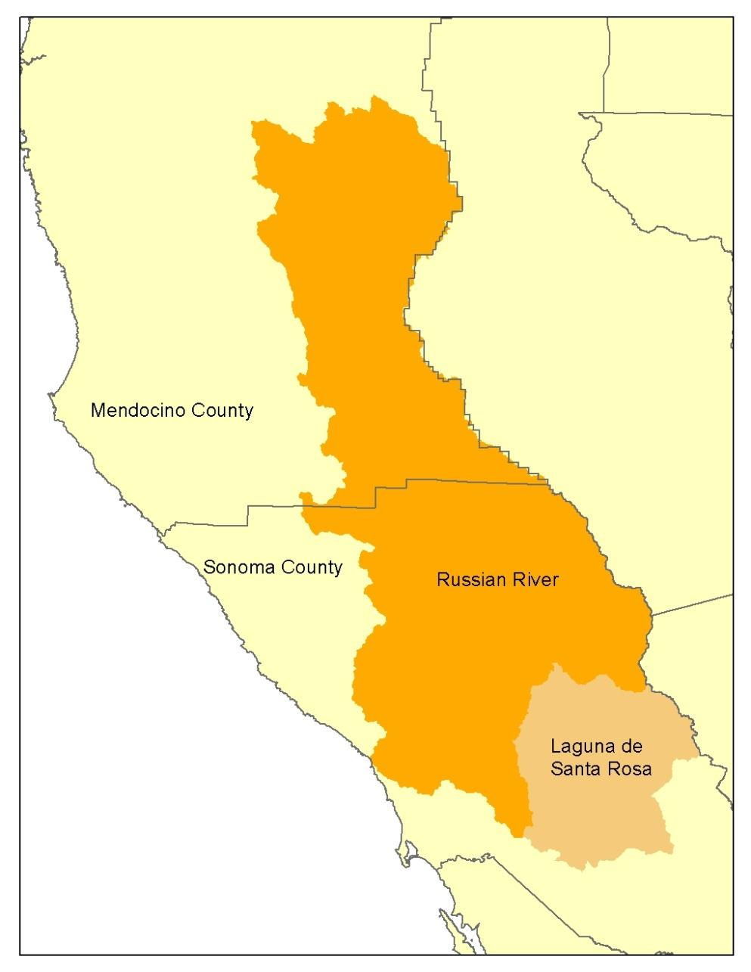
Laguna de Santa Rosa Watershed
Largest tributary of Russian River (254 mi²)
Metropolitan center of the North Coast Region
70 mi² of “Important Farmland” (per CA Dept. of Conservation)
Largest freshwater wetlands complex on northern CA coast
“Wetland of International Importance” (per Ramsar)

Slide 5
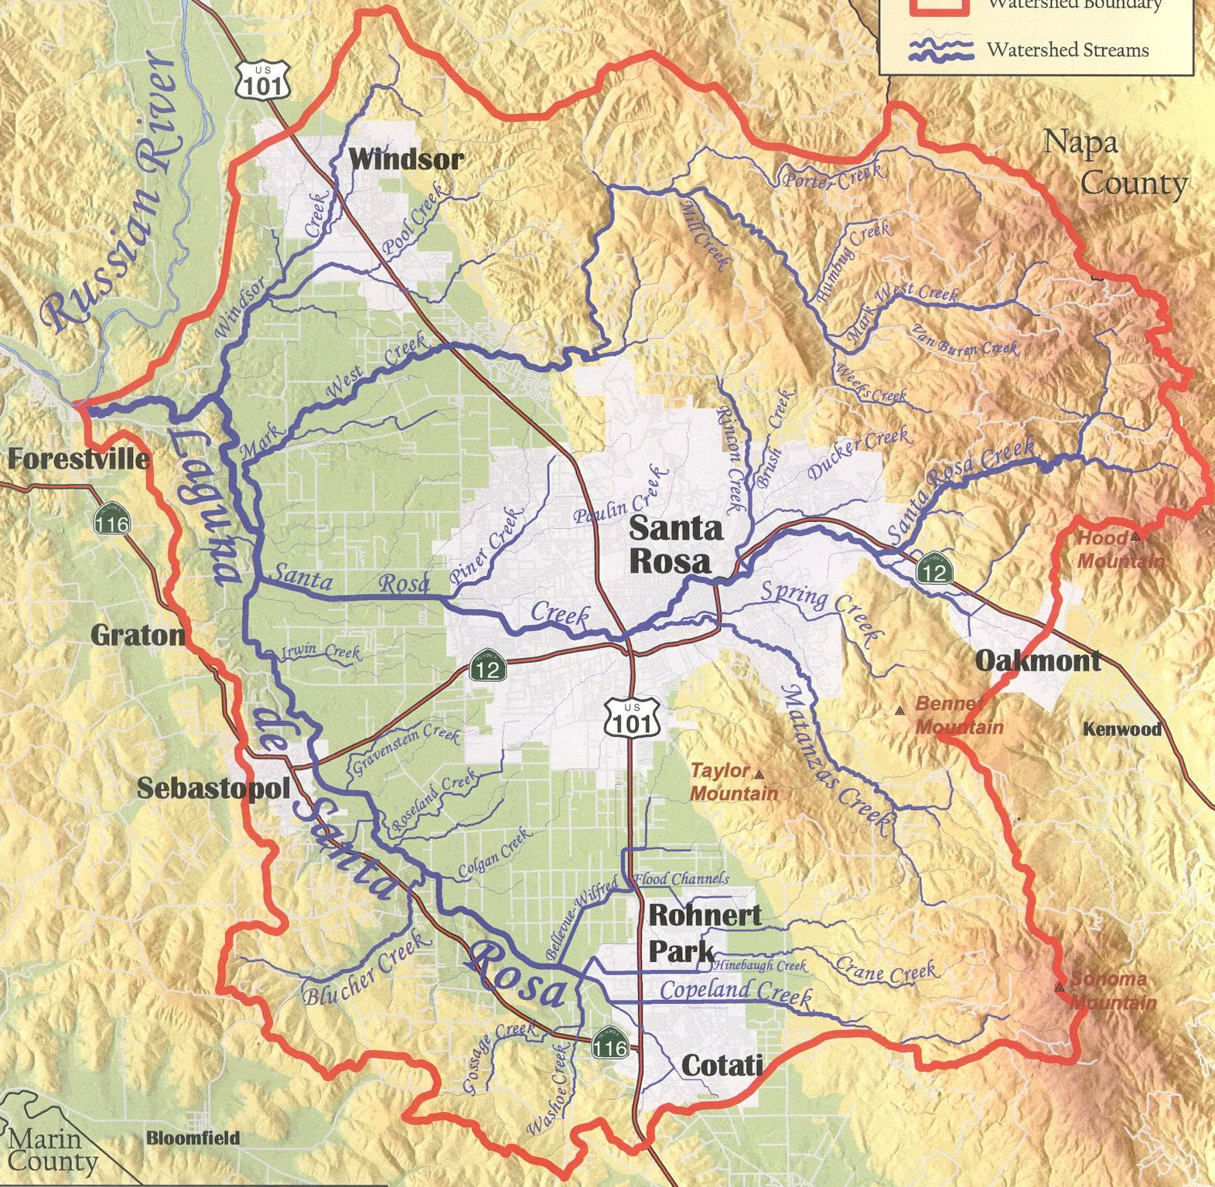
Laguna de Santa Rosa Watershed
Waterbodies:
Windsor Creek
Mark West Creek
Santa Rosa Creek
Copeland Creek
Laguna de SR
Municipalities:
Windsor
Santa Rosa
Rohnert Park
Cotati
Sebastopol

Slide 6
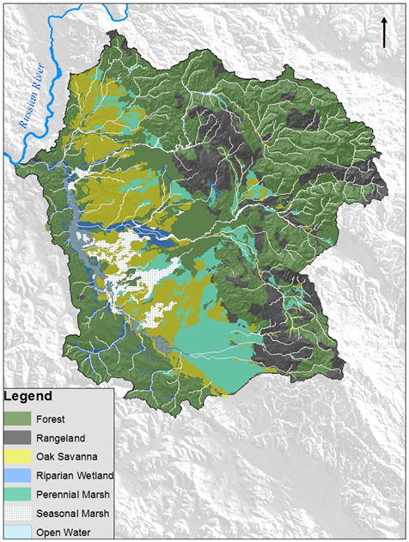
Laguna de Santa Rosa Watershed
Pre-European Settlement Conditions

Slide 7
Historic Landscape Alterations
Widespread Urban and Agricultural Development
Elimination of Functional Wetland and Riparian Areas
Increased Impervious Cover
Installation of Roads, Crossings & Bridges
Increased Channelization & Straightening of Surface Drainage Features
Major Re-alignment of Mark West Creek

Slide 8
Laguna de Santa Rosa Watershed
303(d) Impairments:
Phosphorus
Dissolved Oxygen
Sediment
Temperature
Pathogens
Mercury
Aluminum
Manganese

Slide 9
What is a Total Maximum
Daily Load (TMDL)?
Quantitative Assessment
  Water Quality Problems
  Contributing Sources
  Targets & Linkages
  Load Reductions & Allocations
Implementation Plan
Monitoring Plan

Slide 10
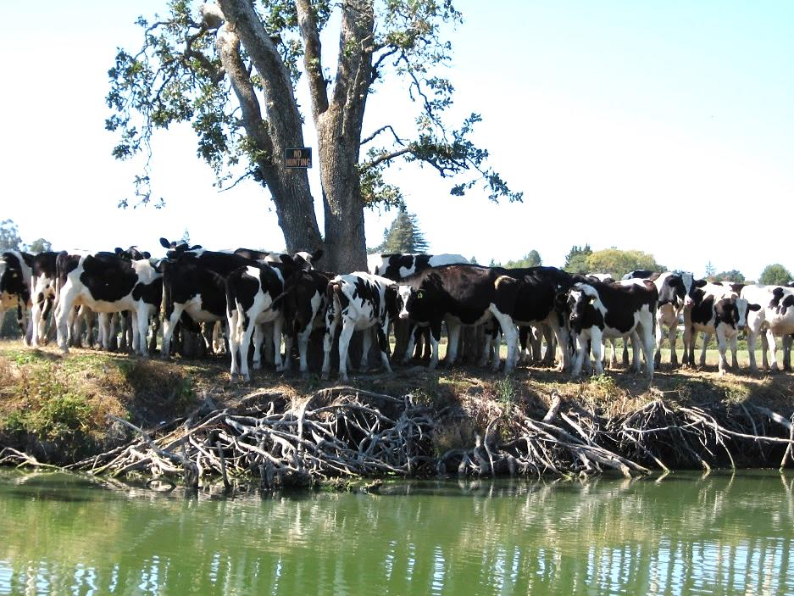
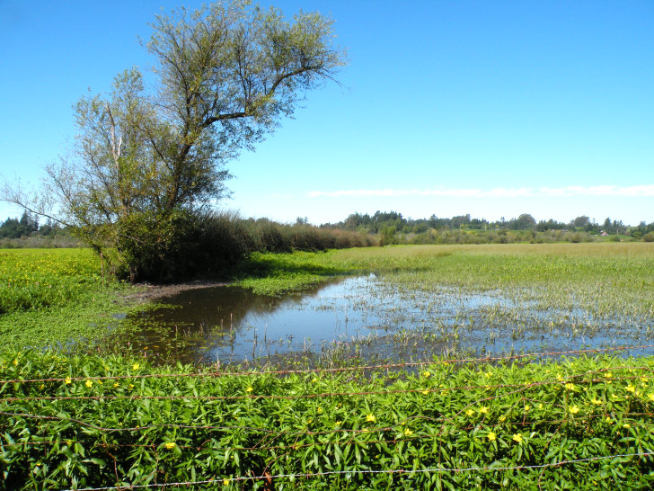
Initial Conclusions
Reduce
Pollutant Sources
+
Increase
Assimilative Capacity
Diet
+ Exercise!

Slide 11
Vision for Beneficial Use Recovery in the Laguna
Point Source Control Programs
Nonpoint Source Control Programs
Laguna Watershed Stewardship Framework
Water Quality Trading Framework
Regionally- Coordinated Monitoring
Restoration Planning & Actions
Partnership Support & Coordination

Slide 12
Recent Developments Related to WQT in the Laguna de Santa Rosa
Regional Water Board Actions
Local Stakeholder Recommendations for WQT
Draft WQT Framework
National Guidance & Resources

Slide 13
Regional Water Board Actions
Related to WQT in the Laguna
2006 – Approved “no net loading” effluent limitations for nutrients in an NPDES permit for the City of Santa Rosa
2008 – Approved the Santa Rosa Nutrient Offset Program by Resolution
2012 – Approved the first project under the Nutrient Offset Program (followed by two others)

Slide 14
Regional Water Board Actions
Related to WQT in the Laguna
2013 – Renewed “no net loading” effluent limitation for total phosphorus in an NPDES permit for the City of Santa Rosa
2013 – Established “no net loading” effluent limitation for total phosphorus in an NPDES permit for the Town of Windsor
2017 – Consider Approving a new Water Quality Trading Framework to replace the existing Santa Rosa Nutrient Offset Program

Slide 15
Development of Local Stakeholder Recommendations for WQT
USDA Conservation Innovation Grant (CIG) awarded to Sonoma and Gold Ridge RCDs
3-year, focused, collaborative effort with national experts and local stakeholders
Regional Water Board staff served as technical advisor
Final report contains local stakeholder recommendations for WQT in the Laguna

Slide 16
CIG Project Participants
Sonoma and Gold Ridge RCDs
City of Santa Rosa
Town of Windsor
Technical Consultants
  Kieser and Associates
  Merritt Smith Consulting
  Texas Institute for Applied Environmental Research
  Willamette Partnership
Agencies
  USDA Natural Resources Conservation Service
  Regional Water Board
  CA Dept. of Conservation
Local Organizations
  UC Cooperative Extension
  RR Watershed Protection Committee
  Russian Riverkeeper
  Sonoma County Ag Preservation and Open Space District
  Sonoma County Water Agency
  Laguna de Santa Rosa Foundation
Ag Stakeholder Advisory Committee
  Vineyard Operators
  Dairy Farmers
  Crop Farmers
  Turf Farmers
  Equine Facility Operators

Slide 17
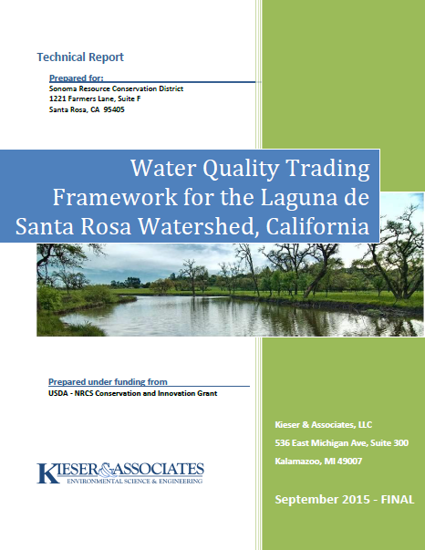
Local Stakeholder Recommendations

Slide 18

Expanding the pace, scope, and effectiveness of conservation
Bobby Cochran
Willamette Partnership
www.willamettepartnership.org
Community, Health, and the Environment

Slide 19
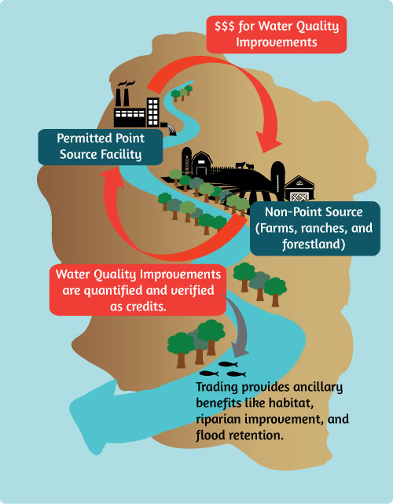
How Does Water Quality Trading Work?

Slide 20
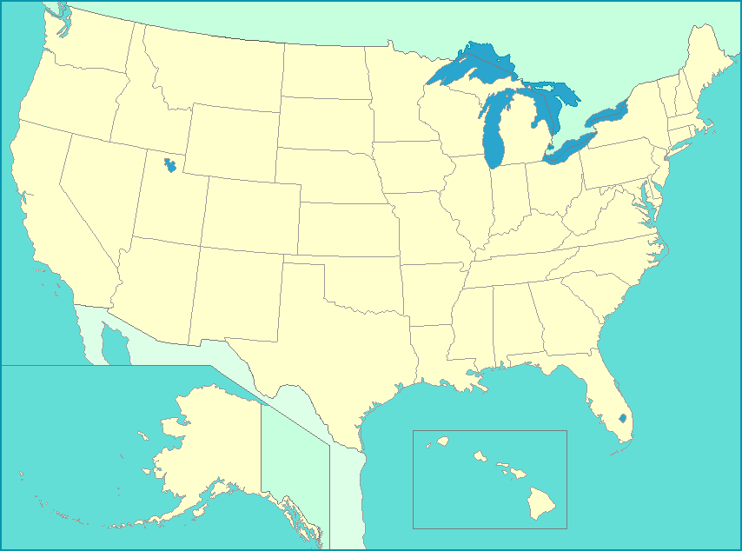
Water Quality Trading Programs in the U.S.
Active Trading
Enabling Policy

Slide 21

National Network’s Options and Considerations Document

Slide 22
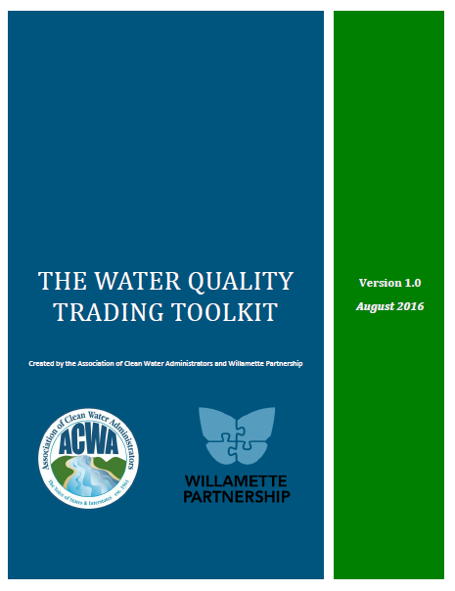
ACWA Trading Framework Template

Slide 23
Recent Developments Related to WQT in the Laguna de Santa Rosa
Regional Water Board Actions
Local Stakeholder Recommendations for WQT
Draft WQT Framework
National Guidance & Resources

Slide 24
Support for Revising the Santa Rosa Nutrient Offset Program
Promote restoration actions in the Laguna
Reflect most recent scientific findings
Establish a compliance option for the Town of Windsor
Activate local stakeholder recommendations
Put national guidance and templates into use

Slide 25
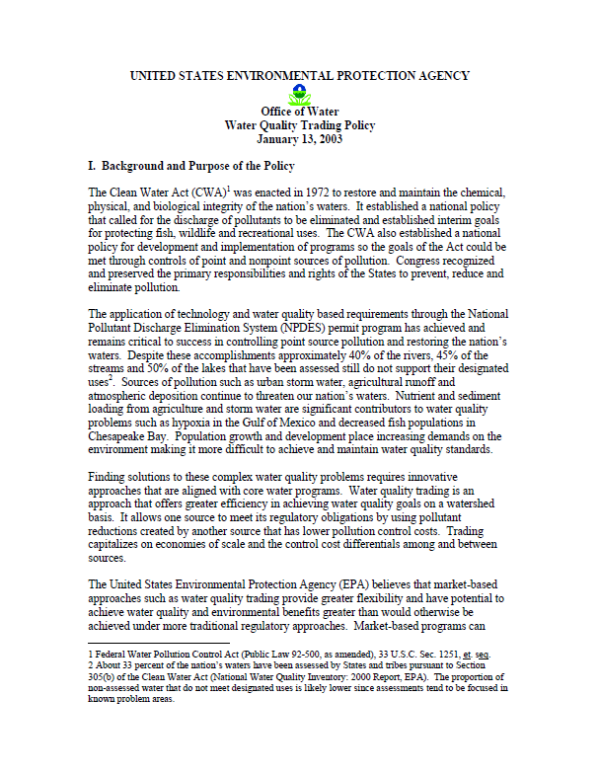
Foundational References for the
Laguna WQT Framework

Slide 26
Staff’s Approach for Developing the Draft Framework
Utilize ACWA Framework Template
Adhere to Local Stakeholder Recommendations
Rely on the National Network’s Options and Considerations Document as a reference guide
Consult with known interested parties regarding framework preferences
Emphasize efficiency, predictability, transparency, best science

Slide 27
Guiding Principles for WQT in the Laguna de Santa Rosa
All actions must be supported by sound science and accomplish regulatory and environmental goals.
Trading activities must offer sufficient accountability, transparency, accessibility, and opportunities for public involvement to ensure that promised water quality improvements are delivered.
The water quality benefits of any trade must be realized in place, in kind, and in time.

Slide 28
Draft Framework Structure
Policy & Regulatory Instruments
Trading Basics
Trading Eligibility Criteria
Quantifying Pollutant Reductions
Trading Ratios
Credit Characteristics
Project Planning, Pre-screening, & Approval
Project Implementation & Verification
Credit Certification, Registration & Tracking
Compliance and Enforcement
Framework Improvements and Monitoring

Slide 29
Laguna Water Quality Trading Flow Chart
Credit Demand
Propose & Approve Beneficial Practices
Evaluate Project Sites, Eligibility & Baseline Requirements
Propose & Approve Credit-Generating Projects
Verify Project Implementation & Maintenance
Certify & Register Credits
Buy/Sell Credits, Track & Account
Credit Supply

Slide 30
Next Steps
(following today’s discussion)
Close of Public Comment Period: July 21, 2017
Staff Response to Comments and Revisions
Regional Water Board Adoption Hearing: December 13, 2017
Proceed with Laguna TMDLs and Beneficial Use Recovery Efforts

Slide 31
Thank You!
Please refer all questions or comments related to the Draft Resolution and Draft Framework to:
David Kuszmar, P.E.
david.kuszmar@waterboards.ca.gov
(707) 576-2693
Written comments due: July 21, 2017
Send to: northcoast@waterboards.ca.gov

